Slide 1
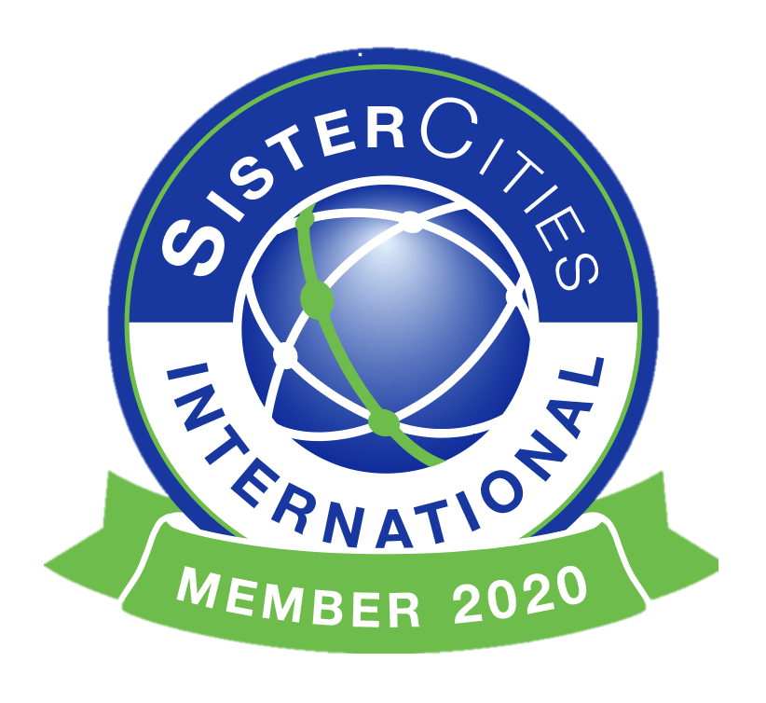
St. Louis Sister Cities Tour around The World

Slide 2
The St. Louis Sister Cities Program is part of the World Trade Center St. Louis’ international mission. Sanctioned by Sister Cities International (www.sister-cities.org), locally, it supports and coordinates the 16 sister cities programs and provides guidance for those interested in establishing new sister cities relations.
Enjoy a virtual tour of St. Louis Sister Cities and submit your answers to the quizzes after each Sister City to be considered for a raffle!

Slide 3
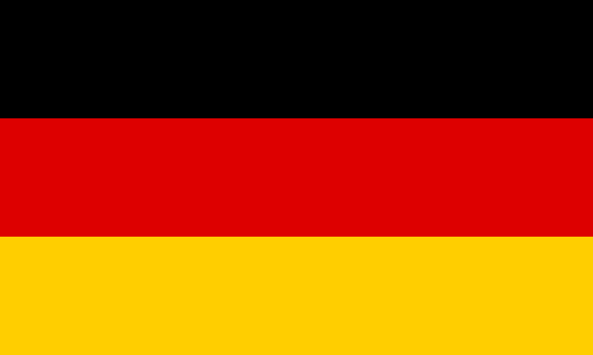
Stuttgart, Germany
Stuttgart is home to….
Porsche
Audi
BMW

Slide 4
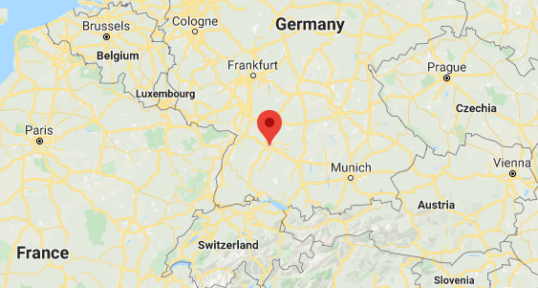
Stuttgart
Where is Stuttgart, Germany?

Slide 6
Stuttgart, Germany
Which one of these is not made in Stuttgart, Germany?
Ford
Porsche
Audi
BMW

Slide 7
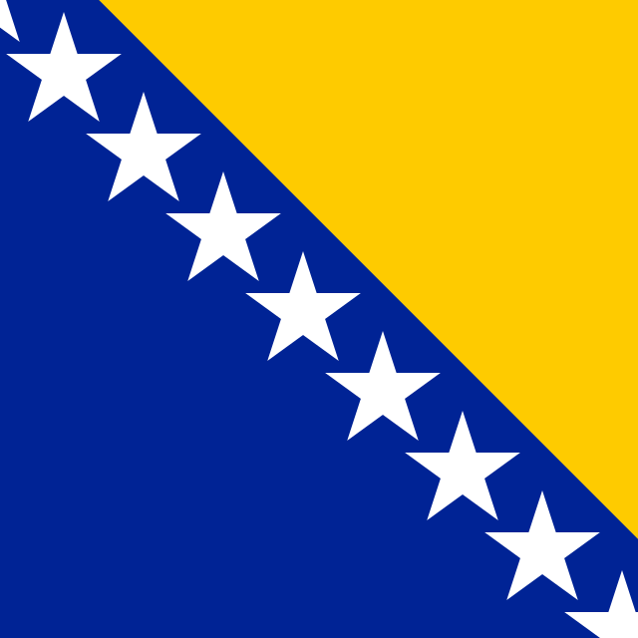
Brčko, Bosnia and Herzegovina
Interesting Facts
St. Louis has the largest Bosnian population outside Europe
Brčko is the only entirely self-governing city in Europe

Slide 8
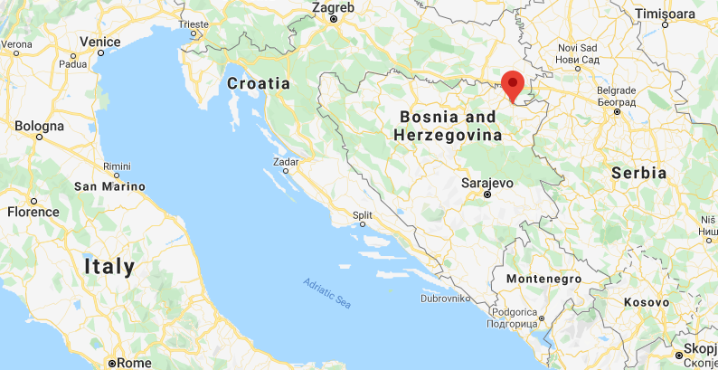
Brcko
Where is Brčko?

Slide 9
Brčko

Slide 10
Brčko, Bosnia and Herzegovina
True or False :
Brčko is the only entirely self-governing city in Europe
True
False

Slide 11
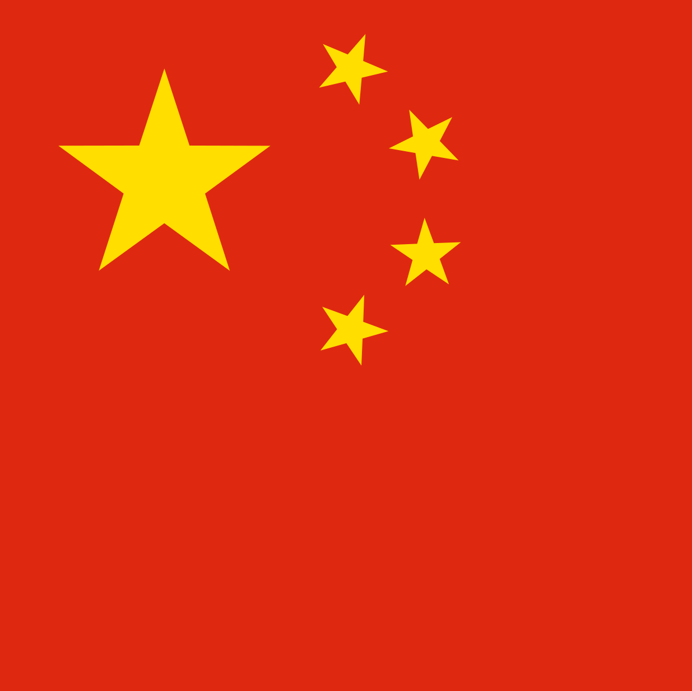
Nanjing, China
Interesting Facts
St. Louis became the first U.S. municipality to have a sister city in the People’s Republic of China (1979)
Mayors of both cities (St. Louis and Nanjing) have led official trade delegations to their respective sister cities
Nanjing was China’s capital during the Six Dynasties (220-589 AD) and the Southern Song Dynasty (1127-1279 AD)

Slide 12
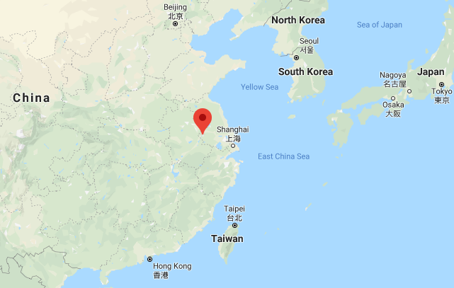
Nanjing
Where is Nanjing, China?

Slide 14
Nanjing, China
What is the Peak in Nanjing that was named after its colorful clouds at dawn and dusk?
Purple Mountain
Red Mountain
The Great Wall
The Forbidden City

Slide 15
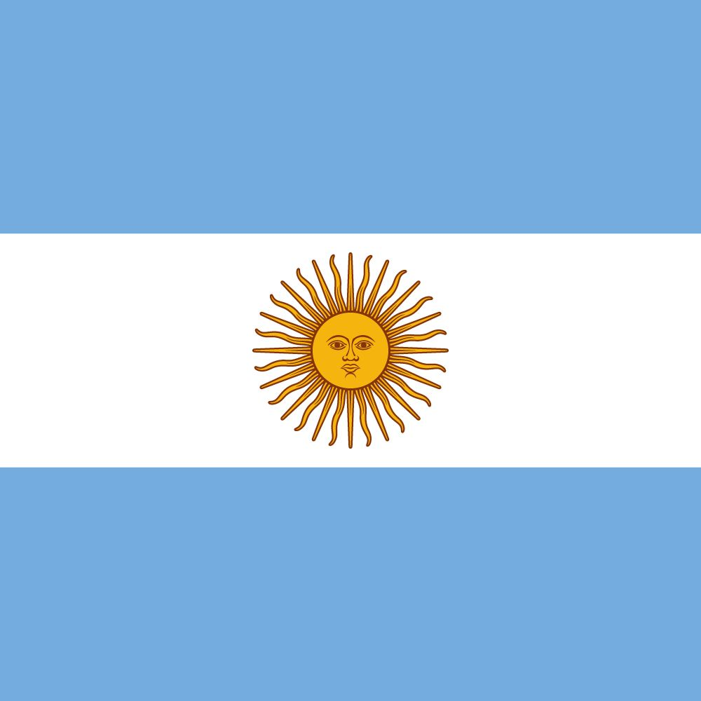
Rosario, Argentina
Interesting Facts
The city sits in the riverbank of Parana River, which is the second longest river in South America after the Amazon River
Soccer is the most popular game in Argentina and famous soccer player Lionel Messi was born in Rosario
Sunday barbeques are called “Asado,” it is typically a charcoal-grilled meat dinner enjoyed with family

Slide 16
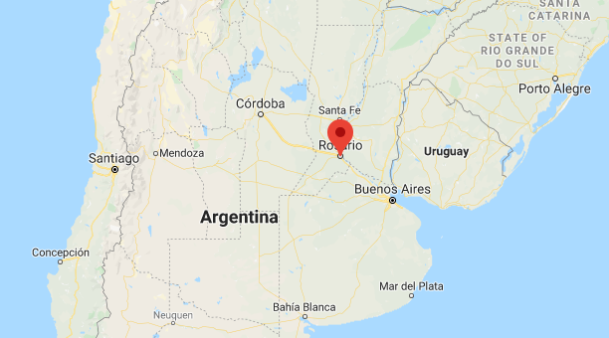
Where is Rosario, Argentina?

Slide 17
Rosario

Slide 18
Rosario, Argentina
What is the South American drink that is made of yerba leaves called?
Mate
Matcha
Coffee
Masala Chai

Slide 19
Bogor, Indonesia
Interesting Facts
Bogor Botanical Gardens are the oldest botanical gardens in Asia
Bogor is famous for its Floating Market
Bogor is nicknamed The Rain City

Slide 20
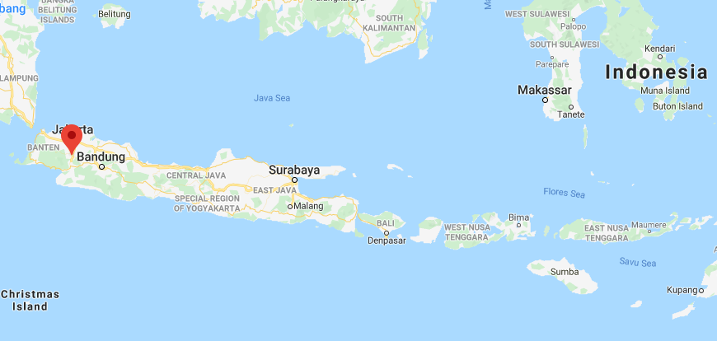
Bogor
Where is Bogor, Indonesia?

Slide 22
Bogor
True or False:
Mount Salak in Bogor is named after the Sanskrit word for “silver.”
True
False

Slide 23
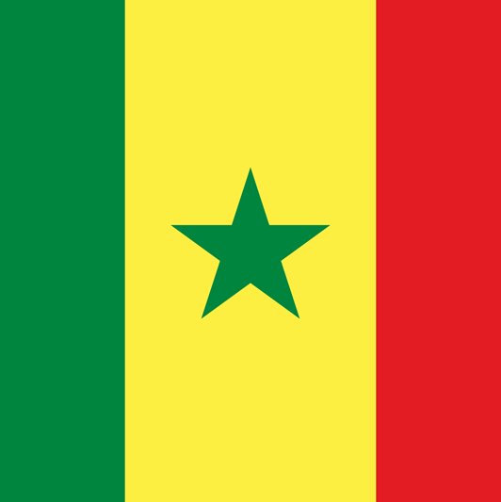
Saint-Louis, Senegal
Nous Avons Plus En Commun Que Seulement Un Nom
More In Common Than Just A Name
Both St. Louis, MO and
Saint Louis, Senegal…..
are located on a river accessed by a bridge
have a university for learning
have a museum that celebrates the arts

Slide 24
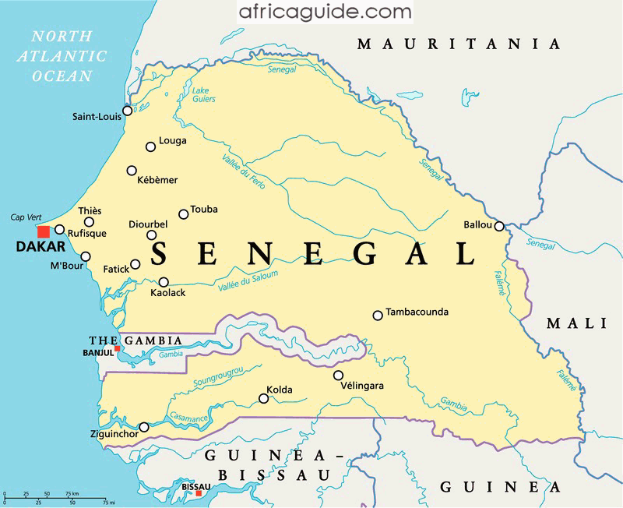
Where is Saint Louis, Senegal?

Slide 25
Senegal

Slide 26
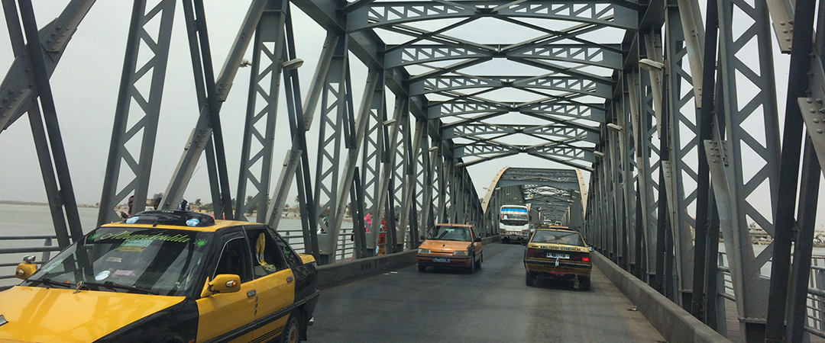
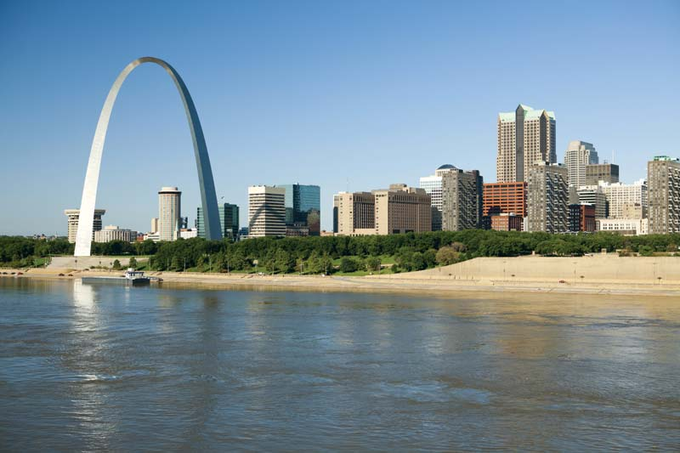
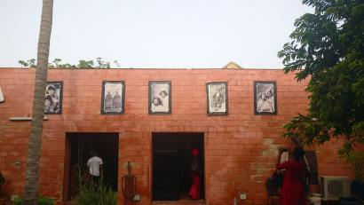
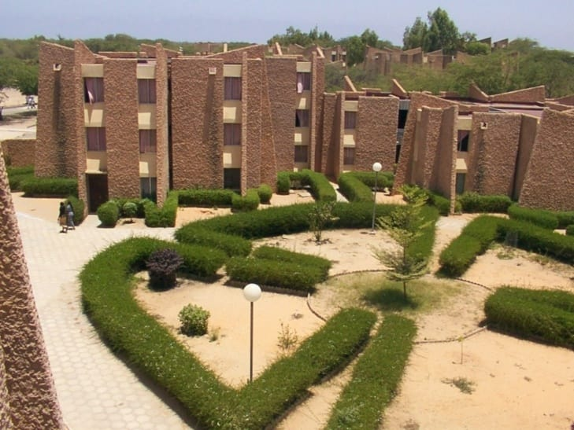
Which one of these locations is not in Saint-Louis, Senegal?
#1
#2
#3
#4

Slide 27
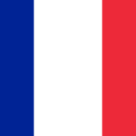
Lyon, France
Interesting Facts
Lyon is the third largest city in France
The city is known for its cuisine and gastronomy
During the Renaissance, the city's development was driven by the silk trade

Slide 28
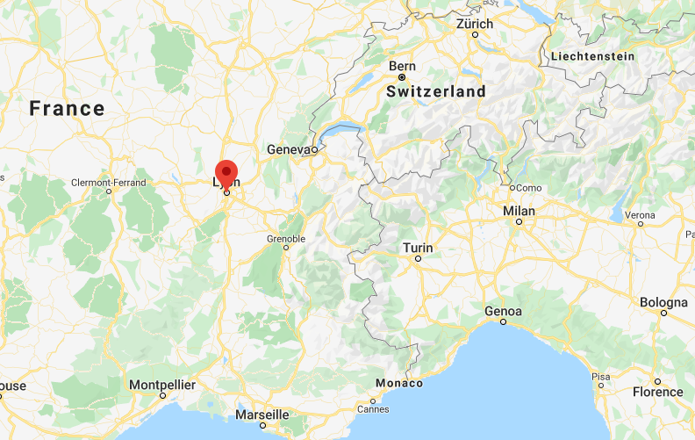
Where is Lyon, France?

Slide 30
Lyon, France
In which part of France is Lyon located?
Southern France
Northern France
Western France
Eastern France

Slide 31
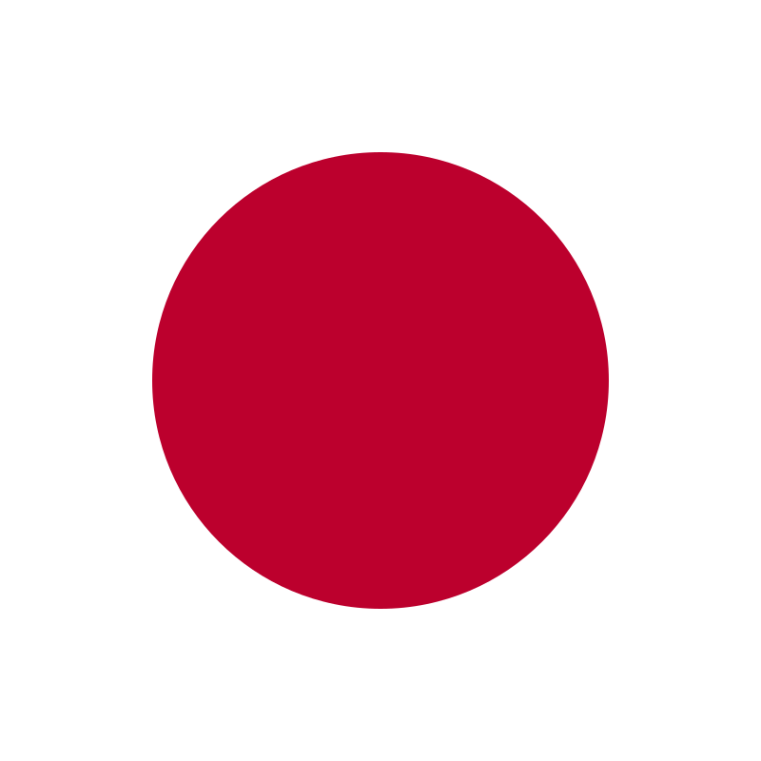
Suwa, Japan
Interesting Facts
Suwa is known for its abundant hot springs
The Missouri Botanical Garden houses gifts (Yukimi lantern and teahouse) from the Suwa delegation to St. Louis from 1977 in the Japanese Garden
Suwa is compared to Switzerland for its scenic mountainous region

Slide 32
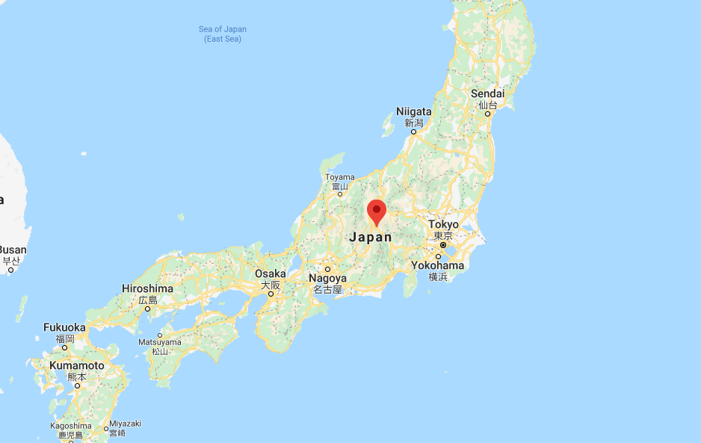
Suwa
Where is Suwa, Japan?

Slide 33
Suwa

Slide 34
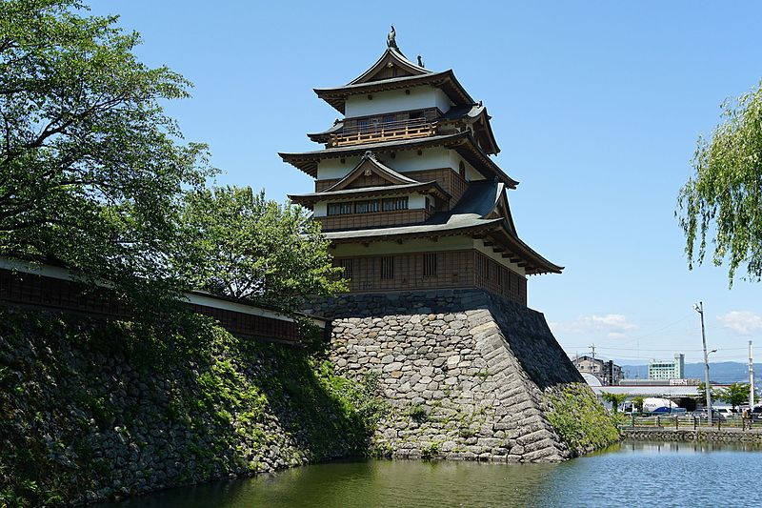
Suwa, Japan
Below is a picture of Takashima Castle in Suwa.
What is this castle also known as?
The Lonely Castle
The Big Castle
The Floating Castle
The Old Castle

Slide 35
Wuhan, China
Interesting Facts
Wuhan was the capital of China in 1927
Wuhan is one of the largest university towns in the world
Wuhan hosts one of the world’s oldest operas in China

Slide 36
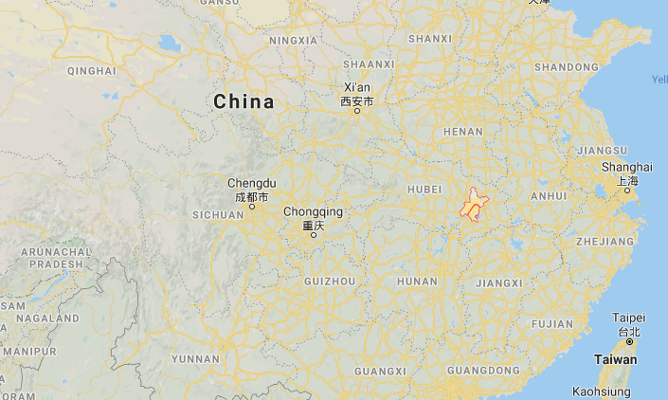
Wuhan
Where is Wuhan, China?

Slide 38
Wuhan
True or False:
With its transportation networks, Wuhan is often referred to as the Chicago of China
True
False

Slide 39
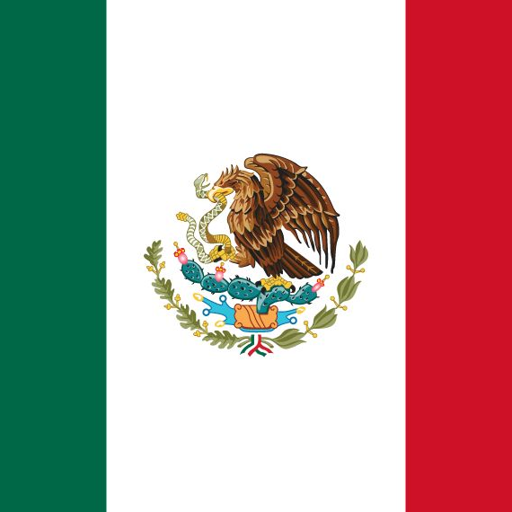
San Luis Potosí, Mexico
Interesting Facts
San Luis Potosí is rich in history and therefore has many tourist attractions
San Luis Potosí was a major gold and silver mining hub during the mid-16th to 19th centuries.
San Luis Potosí has a diverse biodiversity

Slide 40
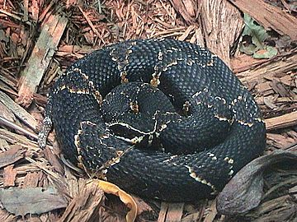
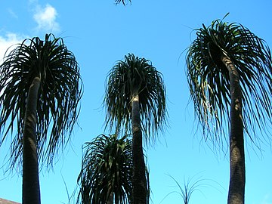
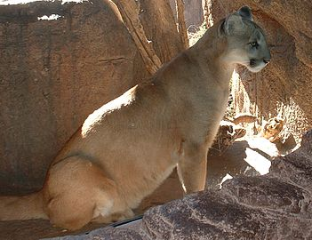
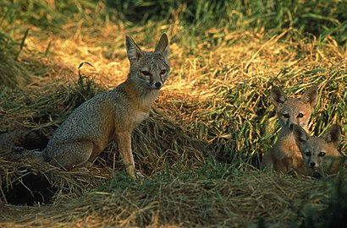
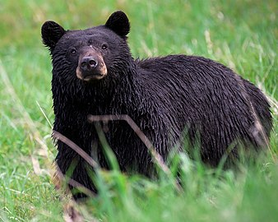
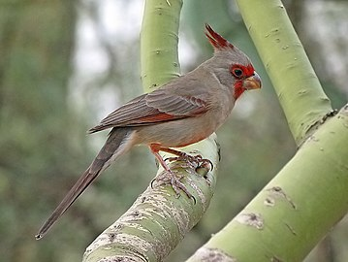
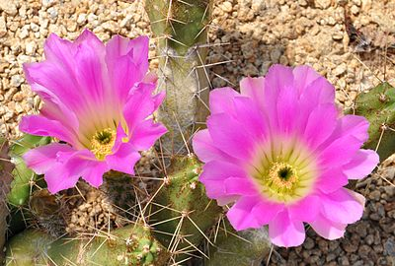
Flora and fauna (plants and animals) of San Luis Potosí
Pictures from Wikipedia

Slide 41
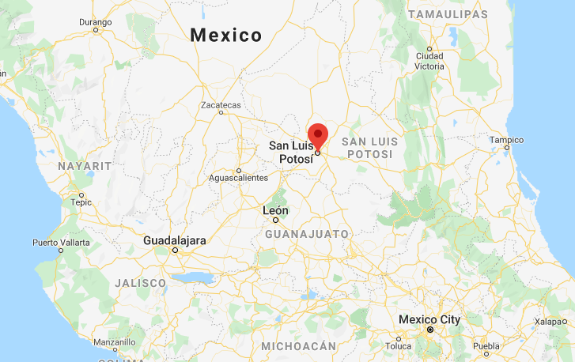
Where is St. Louis Potosi, Mexico?

Slide 43
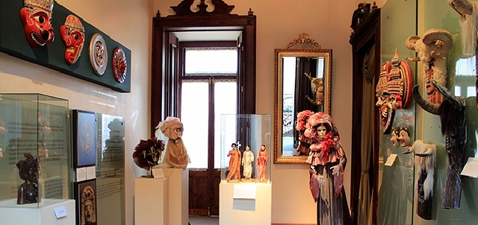
San Luis Potosí
San Luis Potosí is rich in history and therefore has many tourist attractions.
Which site is in the picture below?
National Mask Museum
Train Museum
Metropolitan Cathedral of San Luis Potosí
Plaza Del Carmen

Slide 44
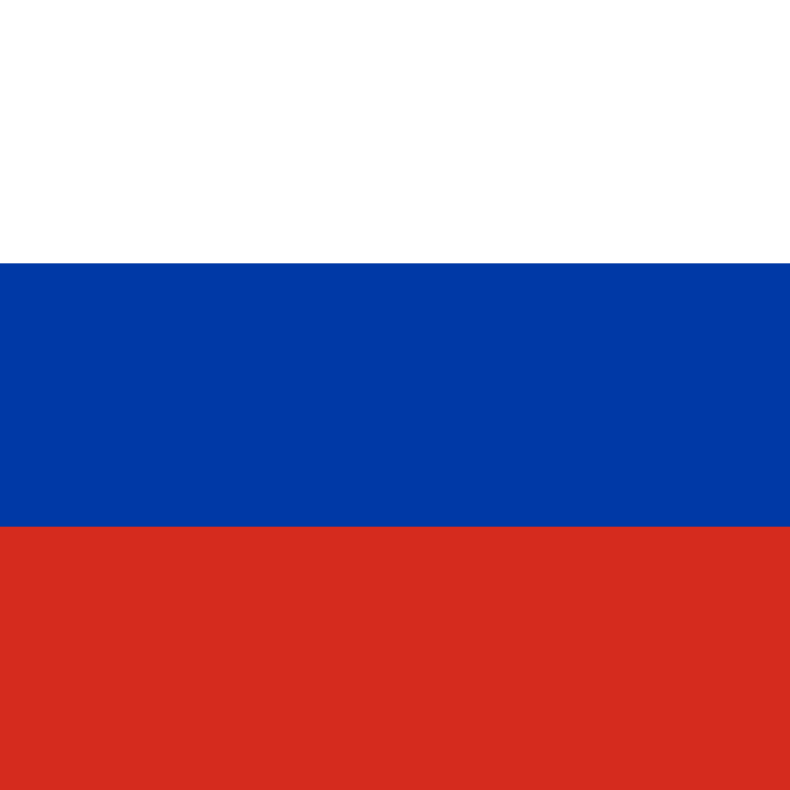
Samara, Russia
Interesting Facts
Samara sits on the banks of the Volga and Samara Rivers; it is a major river port and rail center
Samara has the longest embankment in Russia
Famous writer Leo Tolstoy lived in Samara

Slide 45
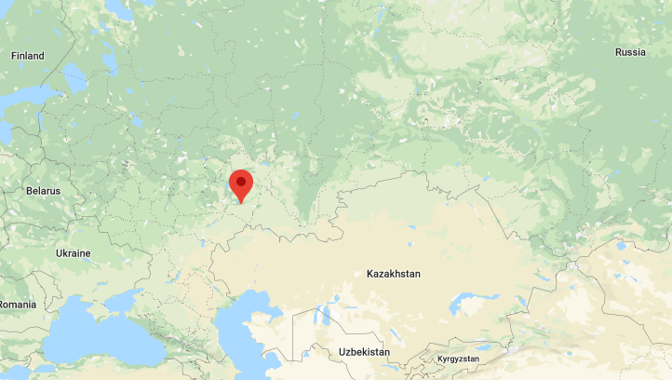
Samara
Where is Samara, Russia?

Slide 46
Samara

Slide 47
Samara
True or False:
Samara hosted the 2018 Russia FIFA World Cup games
True
False

Slide 48
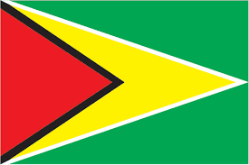
Georgetown, Guyana
Interesting Facts
Guyana is the only South American nation in which English is the official language
Main religion in Guyana is Christianity
Cricket is the most popular sport in Georgetown, Guyana

Slide 49
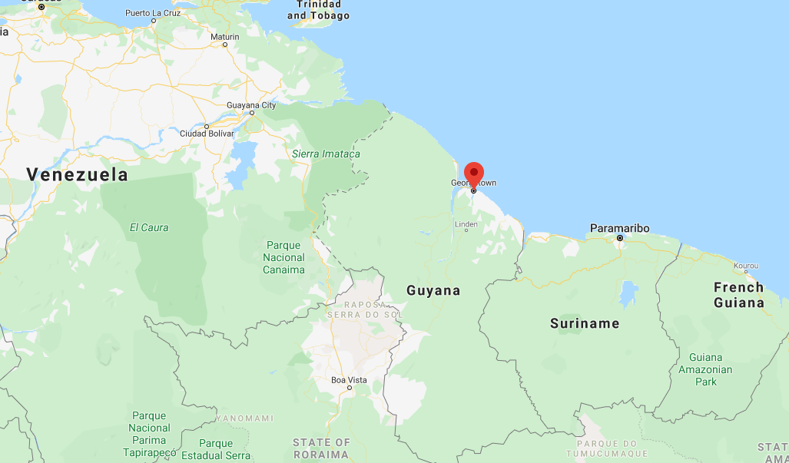
Where is Georgetown, Ghana?

Slide 50
Georgetown, Guyana
Guyana’s capital name honors Britain’s King George lll, while “Garden City of the Caribbean” is a popular nickname for Georgetown.

Slide 51
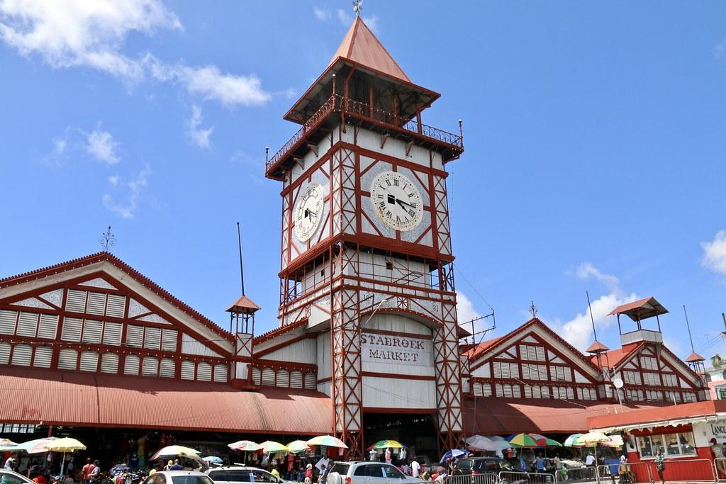
Stabroek Market Clock Tower
St. Louis-Georgetown Sister Cities Logo
The corrugated-iron clock tower of the Stabroek Market (1881) is a landmark in Georgetown, Guyana.

Slide 52
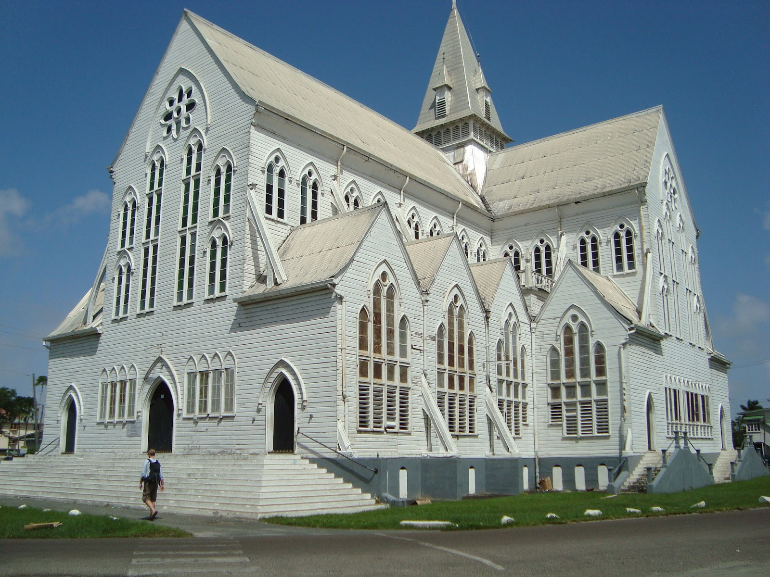
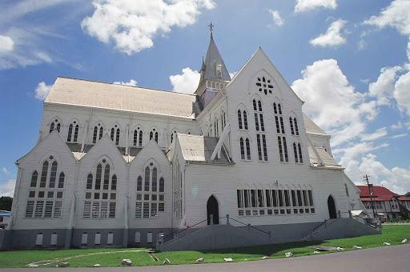
Georgetown’s most impressive building is also one of the tallest wooden churches in the world.
St. George’s Cathedral
The wooden church reaches the height of 43.5 meters (143 ft)

Slide 53
A Crash Course in Guyanese Cuisine

Slide 54
Georgetown, Guyana
What is the most popular sport in Georgetown?
Rugby
Baseball
Soccer
Cricket

Slide 55
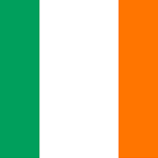
Donegal, Ireland
Donegal is…
The Birthplace of singer/songwriter Enya
#1 on National Geographic’s Cool List in 2017
Famous for its Donegal tweed

Slide 56
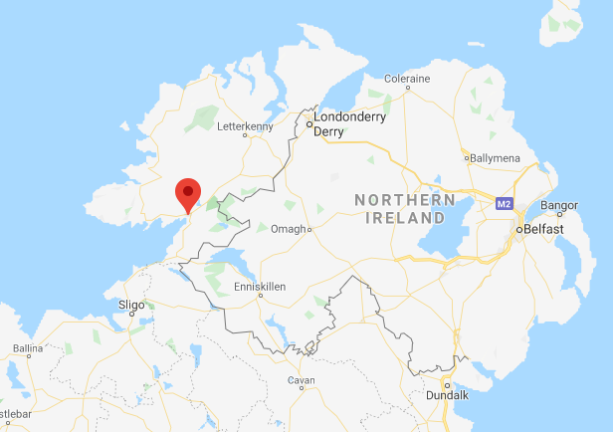
Donegal
Where is Donegal, Ireland?

Slide 57
Donegal

Slide 58
Donegal
True or False:
You can see the Northern Lights from Donegal’s Inishowen Peninsula
True
False

Slide 59
Bologna, Italy
Interesting Facts
Bologna is home to the oldest university in the world, the University of Bologna (est. AD 1088)
Bologna is where the famous Bolognese sauce was first created
There are many medieval structures in Bologna, the two most prominent ones are known as “Two Towers”

Slide 60
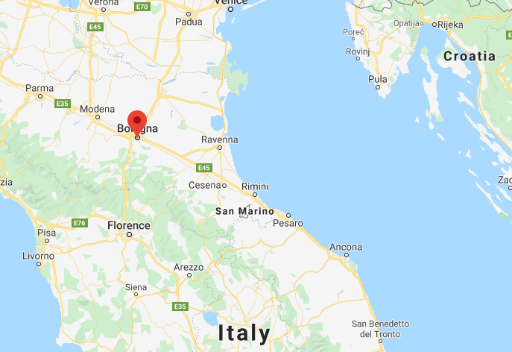
Where is Bologna, Italy?

Slide 62
Bologna, Italy
What is the meat-based sauce in Italian cuisine that originated in Bologna?
Alfredo Sauce
Bechamel Sauce
Hollandaise Sauce
Bolognese Sauce

Slide 63
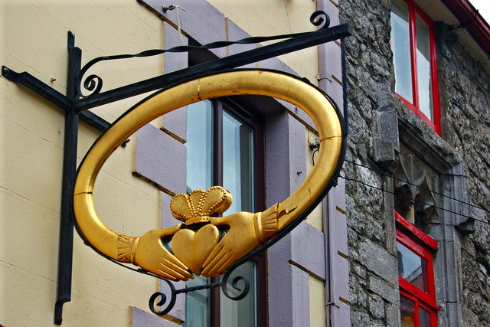
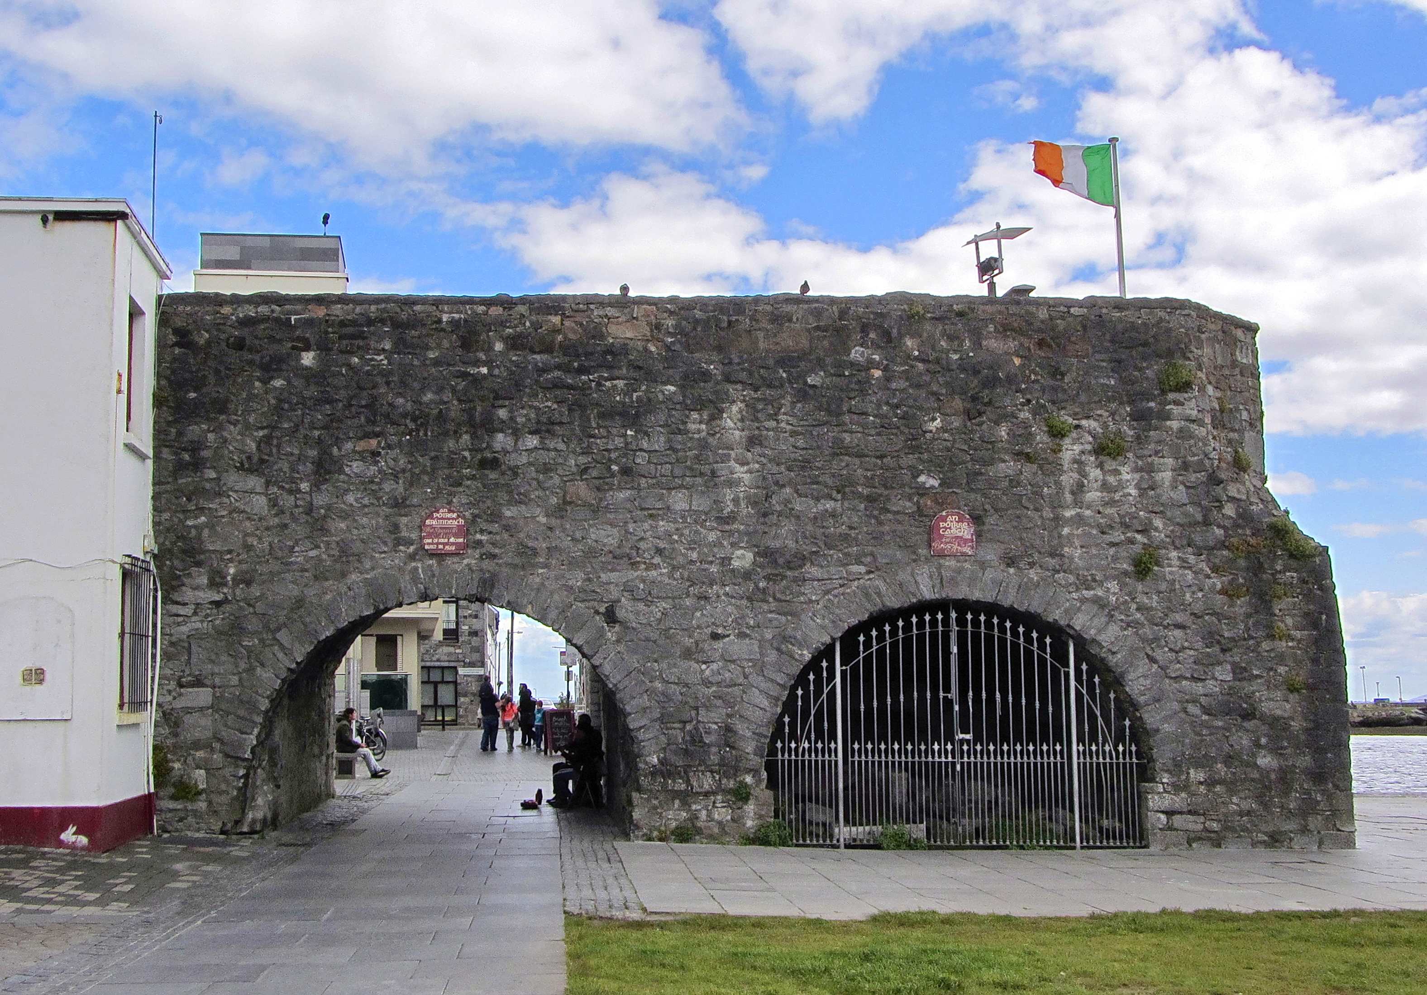
Galway, Ireland
Interesting Facts
Galway is home to the Claddagh Ring
Galway is known as the Gateway to Connemara
Galway is home to the Spanish Arch

Slide 64
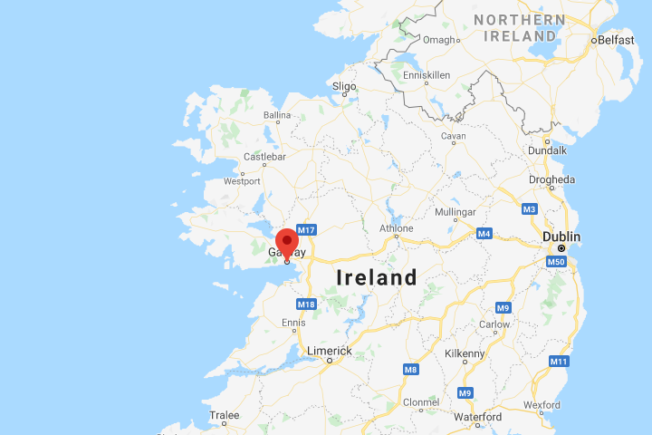
Where is Galway, Ireland?

Slide 65
Galway

Slide 66
Galway
True or False:
Galway is one of only five UNESCO Cities of Film in the world.
True
False

Slide 67
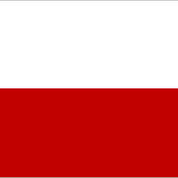
Szczecin, Poland
Szczecin [SHCHETCH-in]
is famous for….
Tall Ships Race
Philharmonic Concert Hall
Underground Tunnels with 5 levels

Slide 68
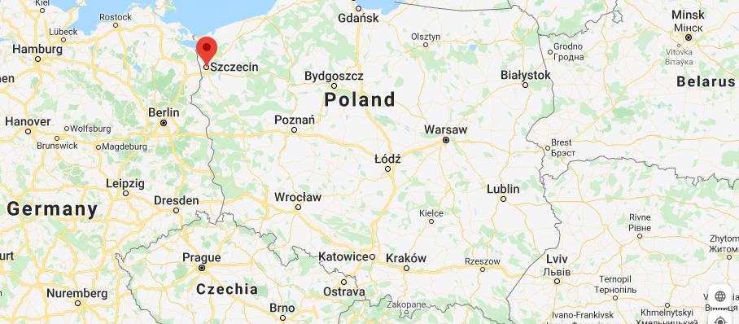
Where is Szczecin, Poland?

Slide 69
Szczecin

Slide 70
Szczecin
True or False:
Szczecin was designed by Georges-Eugene Haussmann, who also designed Paris.
True
False

Slide 71
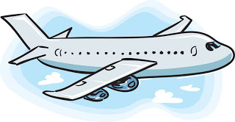
Great job! Make sure to submit your answers to the St. Louis Sister Cities Quizzes!
This Photo by Unknown Author is licensed under CC BY-SA
Click here to take the quiz

